Slide 1
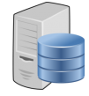

end user application
load balancer
master server
master server
master server
SQL Server DBA Tool
mirroring
mirroring
mirroring
slave server
slave server
slave server
server group info / health check / database backup
object storage
API Gateway

